Slide 1

Ending Our Oil Addiction
June 2013

Slide 2
“Genie, for my third and final wish, I want…”

Slide 3
…All the World’s Money & Power
$102T
$102T
$220,000,000,000,000
$65T
$14T
$8T
Government Debt
Global Market Cap of Listed Co.
Bank
Deposits
World Oil Reserves
World
Gold

Slide 4
The simple truth…
There ISN’T enough money in the world to buy all its oil
Oil is already so expensive,
it is literally BANKRUPTING us

Slide 5
National Fuel Expense (2011)
OIL: 82% of US fuel expense

Slide 6
What should we do?
In the red corner we have the “Drill Baby Drill” and nuclear energy
In the blue corner we have the global warming with solar and wind
Who is right?

Slide 7
How fast can we Drill, Baby, Drill?
Within 5 years there will be more cars in China than in the US
But new oil is harder to find, takes longer to develop and requires a lot more capital
Even with the current record level of domestic drilling oil is still too expensive
Drilling is like trying to outrun a bullet train with a bicycle
It buys us time but it is NOT the solution!

Slide 8
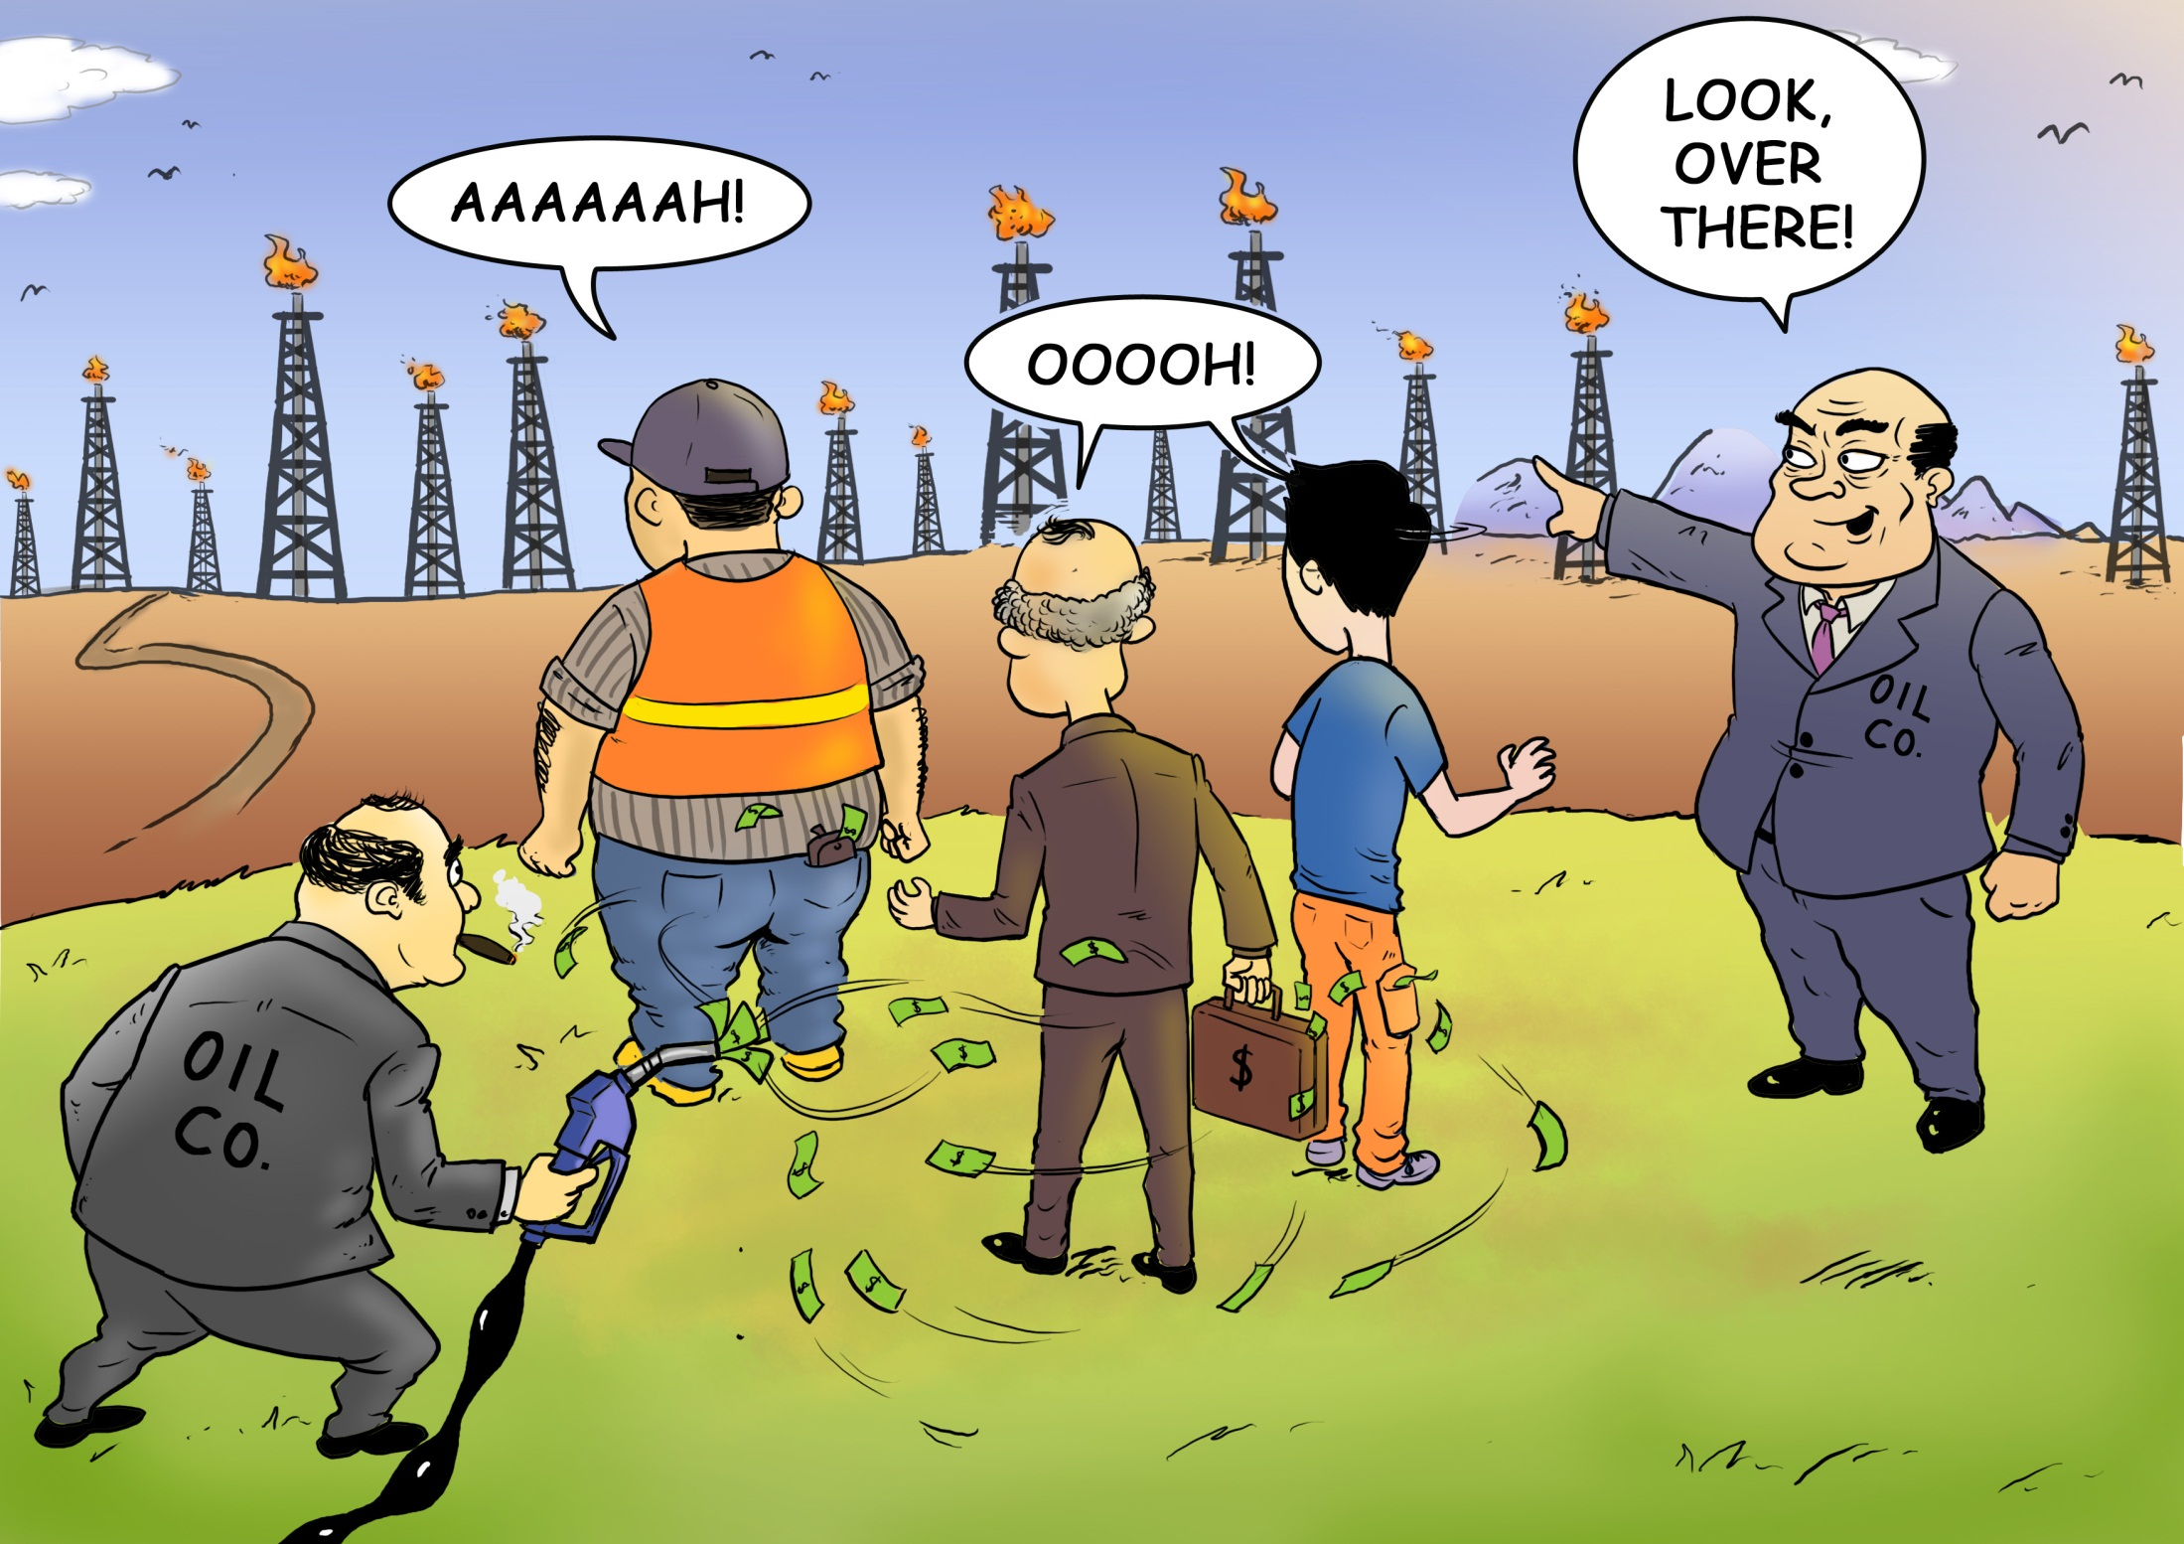

Slide 9
Are we running out of oil?
Not really…
There may be a 1,000 years of oil supply
at $1,000 a barrel
The question is how much oil is there
at $50 a barrel ?
$50 a barrel is equivalent to gasoline at $2.50 per gallon and to the cost of gasoline alternatives

Slide 10
Is the Solution Green Energy?
Green energy is replacing coal
Our problem is replacing oil

Slide 11
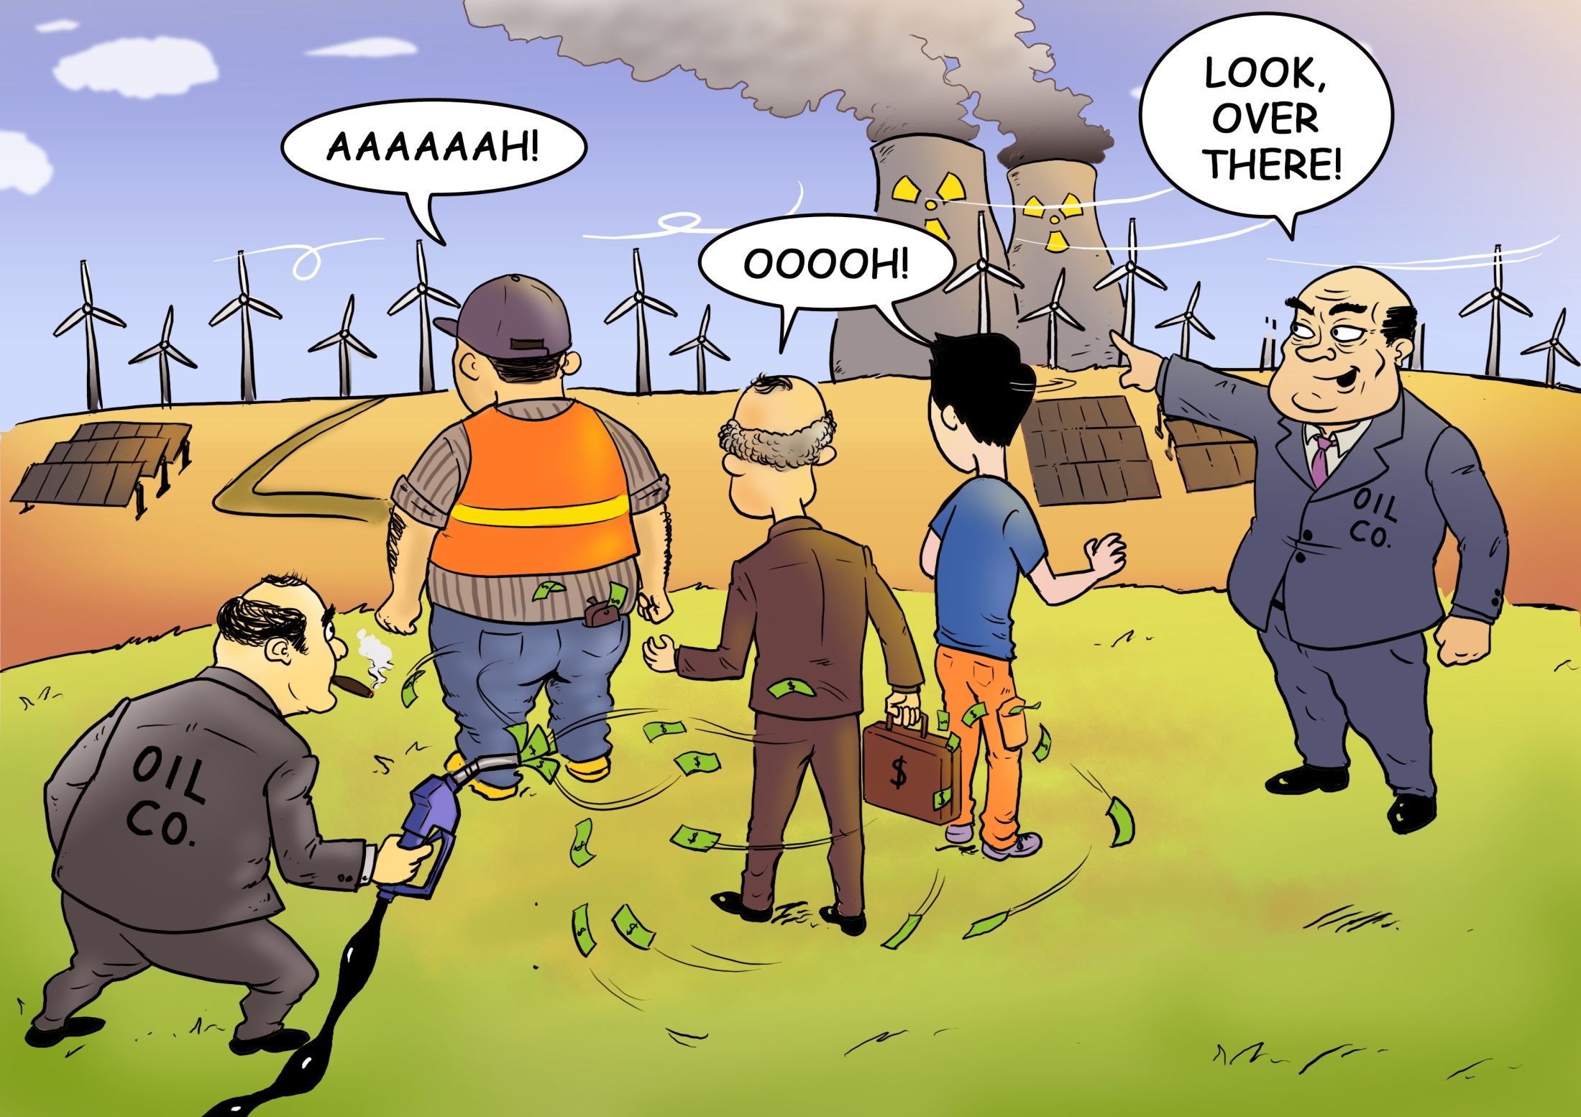

Slide 12
Global Warming:
Choose Your Poison…
Petroleum
coal
Use: Transportation
Direct cost: ~$780 billion
Emission: #1 emitter of both greenhouse gases and urban pollution
Use: Electricity
Direct cost: ~$30 billion
Emissions: distant second
Why are we focusing so much on coal?

Slide 13
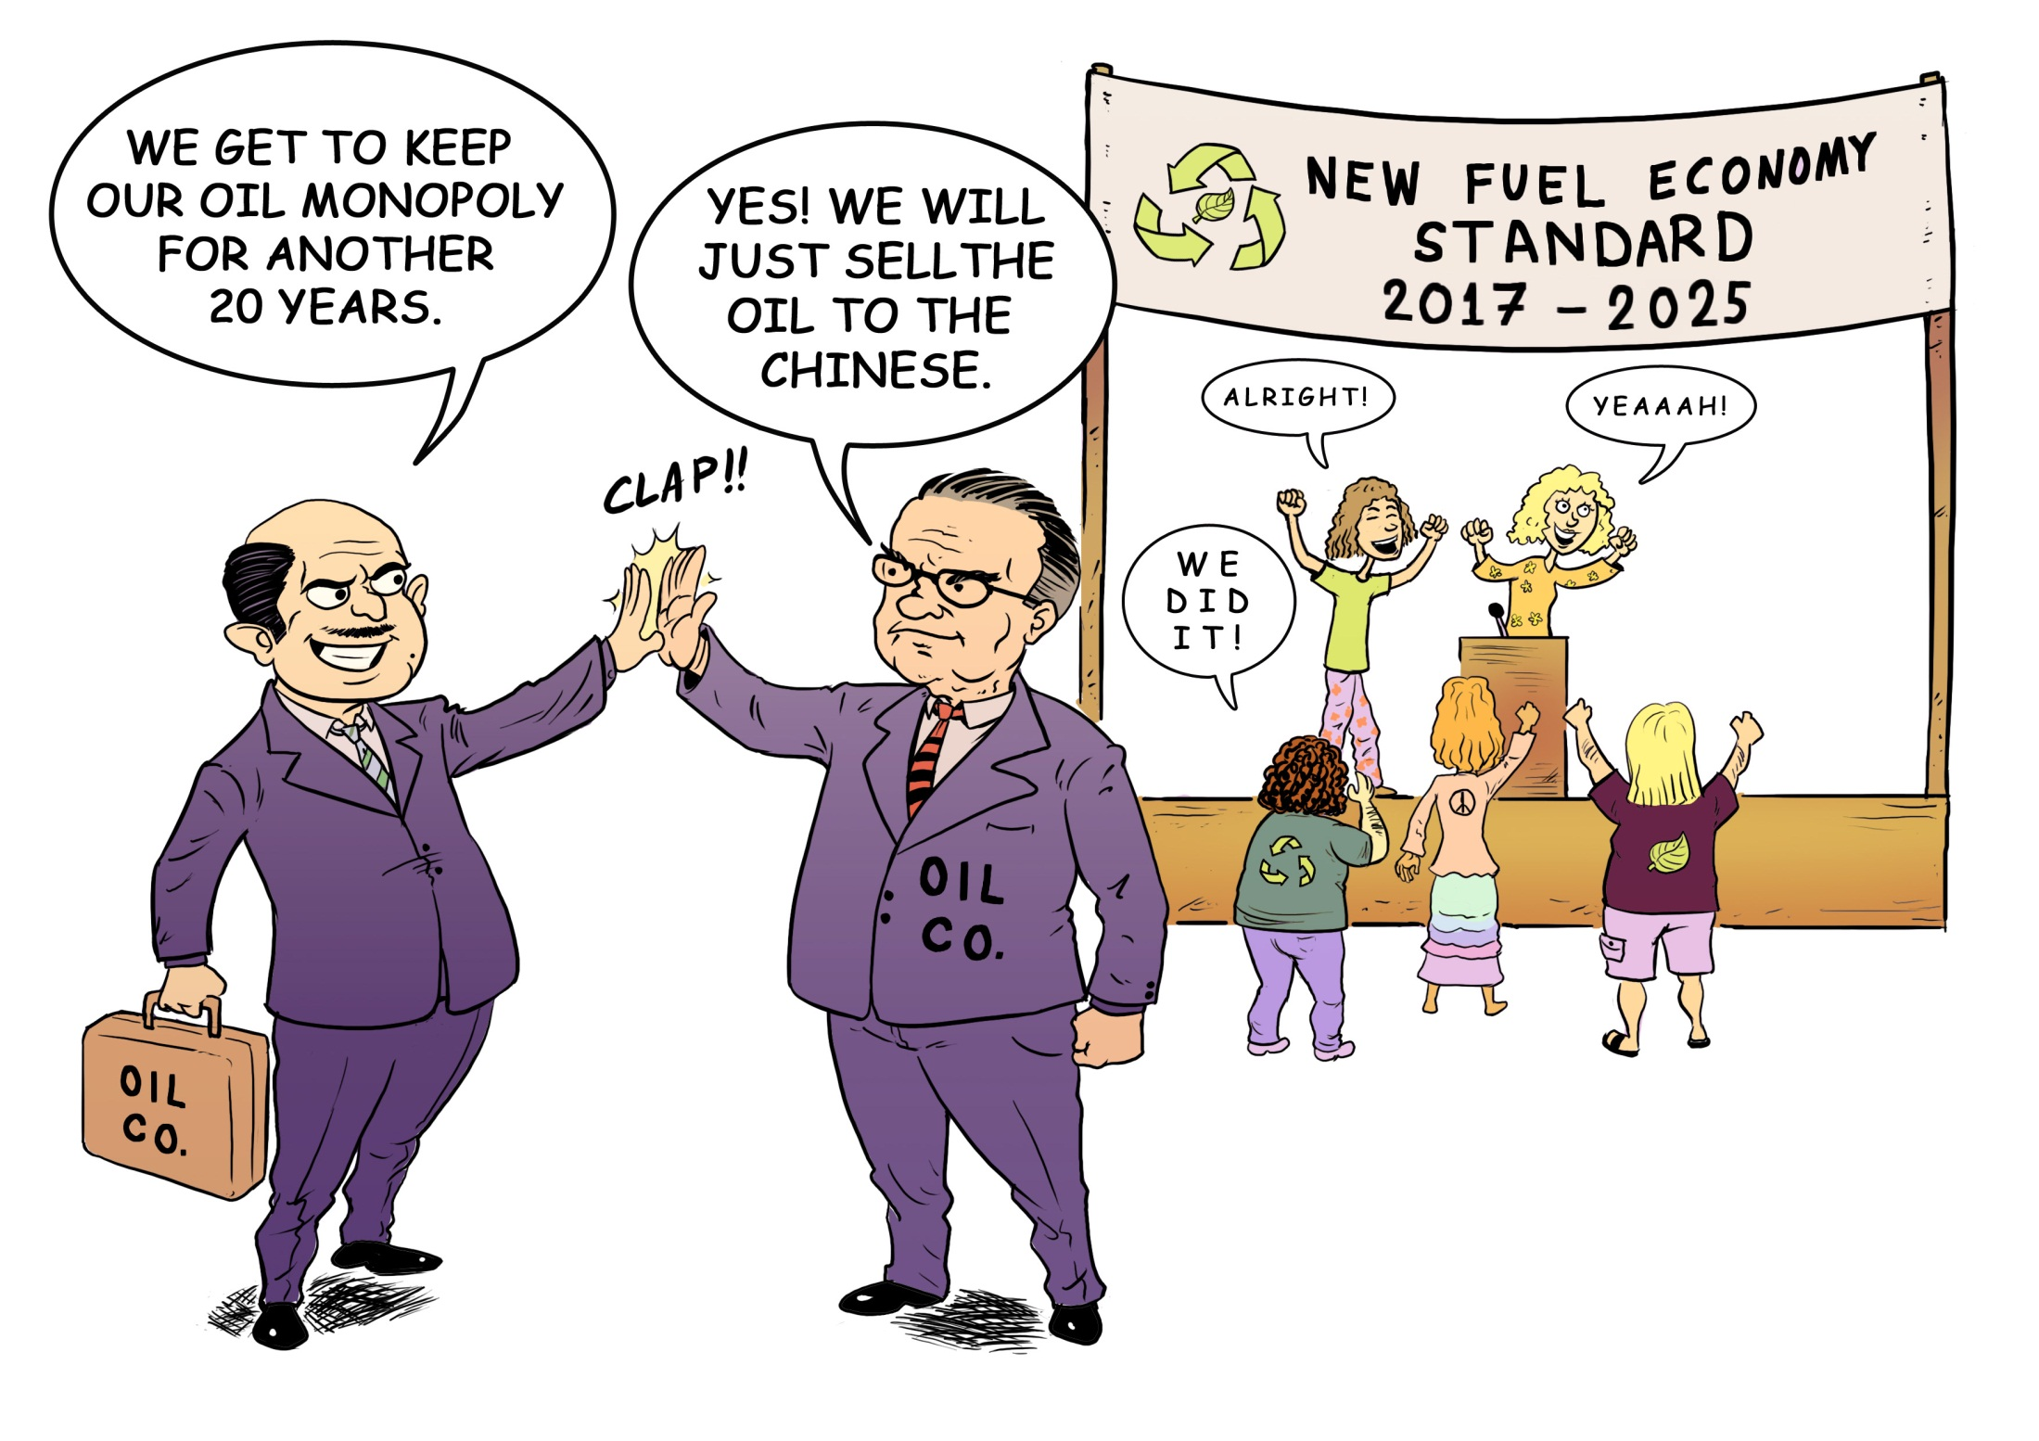

Slide 14
Well then…
If the red corner doesn’t get it…
…and the blue corner doesn’t get it…
… What do we do?
We need to break oil’s monopoly on transportation…

Slide 15
Fuel Freedom Solution
Electricity
Natural Gas
Ethanol
Methanol
All are cheaper than petroleum
All are cleaner & emit fewer greenhouse gases
All are domestically produced and generate American jobs
Notes:
For example

Slide 16
Three Interconnected Market Barriers
Petroleum Only Cars
Gas Stations’
Relationship with Oil Brands
Emissions Regulations

Slide 17
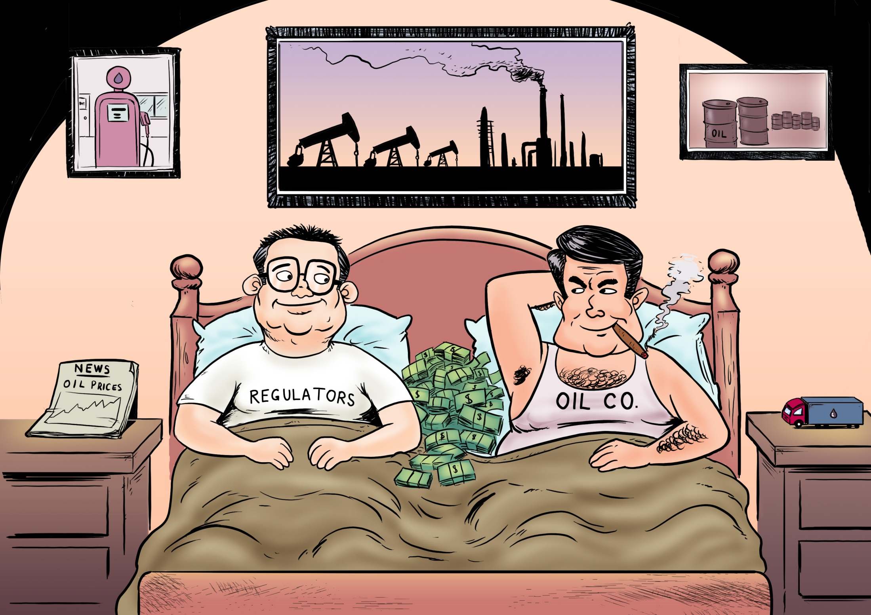

Slide 18
Ending the Oil Addiction
For a modest cost, YOUR car could run on $2.50 replacement fuels tomorrow
Standing in your way are outdated regulations and the existing fuel distribution system
What’s needed is regulatory reform and fuel competition
Fuel Freedom means fuel choice at the pump and at the dealership

Slide 19
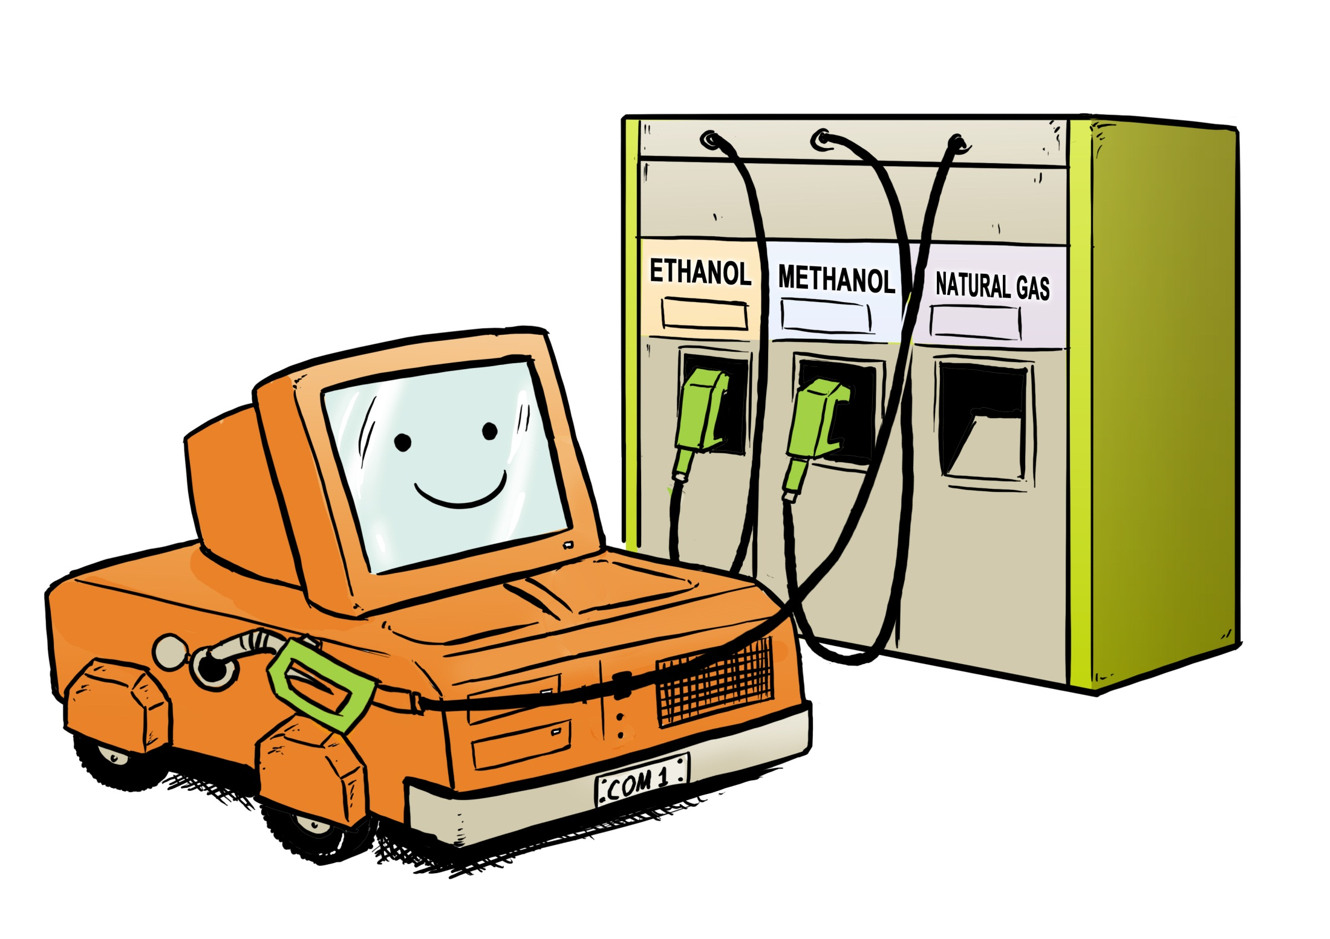

Slide 20
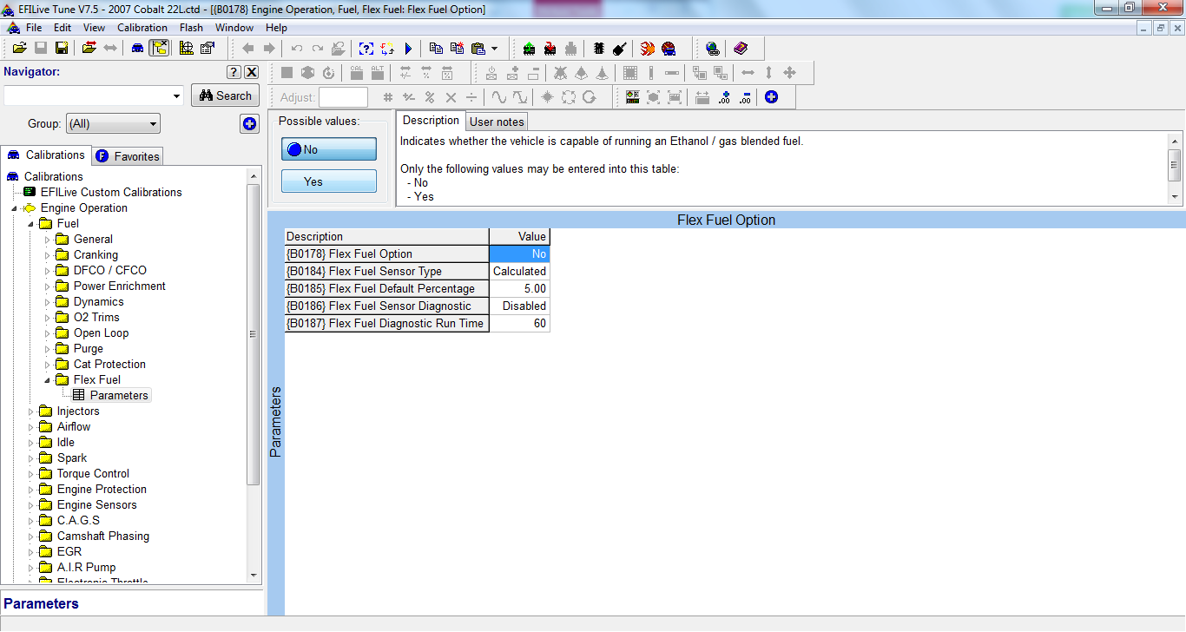

Slide 21
Fuel Freedom Foundation Campaign
Cheaper, Cleaner,
American-Made Replacement Fuels
Outreach and Education
Regulatory Reform
Legal Action
Political Advocacy
Alliance Building
Increase economic growth, reduce poverty, create jobs, reduce the trade deficit, reduce pollution and GHG emissions,
strengthen national and global security

Slide 22
  www.FuelFreedom.org
  Facebook.com/FuelFreedom
  Twitter.com/FuelFreedomNow
Fuel Freedom
Cheaper, Cleaner, Healthier, American-Made

